Slide 1
Machine Learning
Machine Learning Introduction to Machine Learning by Kumar Anurupam is licensed under a Creative Commons Attribution-4.0 International License.
Decision Tree Classification - Introduction
CS 3104 Fall 2019
Lecture Slides by Kumar Anurupam

Slide 2
Learning Objectives
After completion of today’s session you will be able to:
Define Classification Task in ML.
Explain the concept of Decision Tree Classification.
Discuss the advantages and disadvantages of Decision Tree Classification.

Slide 3
Classification
In machine learning, classification is a supervised learning approach in which the computer program learns from the data input given to it and then uses this learning to classify new observation.
It specifies the class to which data elements belong to and is best used when the output has finite and discrete values. It predicts a class for an input variable as well.
It can be divided into further two groups:
Binomial
Multi Class

Slide 4
Application of Classification Task
Speech recognition
Handwriting recognition
Bio metric identification
Document classification
Spam mail detection
And many more…

Slide 5
Types of Classification Algorithm
Linear Model
Logistic Regression
SVM
Non-Linear Model
Naïve Bayes
Decision Tree Classification
K-nearest Neighbors (KNN)
Kernel Support Vector Machines (SVM)
Random Forest Classification

Slide 6
Decision Tree: Motivation

Slide 7
Decision Tree
A decision tree is a flowchart-like structure in which:
Each leaf nodes represent class label.
Non leaf nodes contains attribute test conditions to separate records that have different characteristics.
Branches represent outcomes.
Tree models where the target variable can take a discrete set of values are called classification trees.
Decision trees where the target variable can take continuous values (typically real numbers) are called regression trees.
Decision trees are constructed in a top-down recursive divide-and-conquer manner

Slide 8
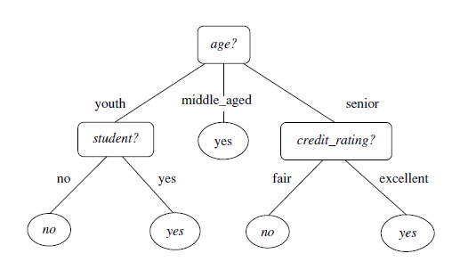
Decision Tree example:
A Decision Tree to decide at a company that a customer is likely to purchase a laptop or not.

Slide 9
Advantages and Disadvantages of Decision Trees
The Construction of decision tree classifier does not require any domain knowledge or parameter settings.
It can handle multi-nominal data.
The learning and classification steps of decision tree induction are simple and fast.
It have good accuracy.
Decision trees are the basis of several commercial rule induction systems.
Decision tree can create complex trees that do not generalize well
Decision trees can be unstable because small variations in the data might result in a completely different tree being generated.

Slide 10
References
[1] https://medium.com/@Mandysidana/machine-learning-types-of-classification-9497bd4f2e14
[2] https://www.simplilearn.com/classification-machine-learning-tutorial

Slide 11
Thanks

